Slide 1

D206 Data Cleaning: Performance Assessment
Jill Rivera, Student
Master of Science in Data Analytics
Western Governors University
Notes:
Hello and welcome. My name is Jill Rivera, and I am a student in the Master of Science in Data Analytics Program at Western Governors University. Today, I will be presenting the performance assessment for course number D206: Data Cleaning.

Slide 2
Performance Assessment Task
Given: Data Dictionary and CSV file containing company data.
Objective: Understand the needs of the company, clean and analyze the data set, and answer a question for the company using the findings.
Notes:
For this assignment, I was given a choice between two data sets and corresponding dictionaries. The topics were telecommunication data for an analysis with churn, or medical data to analyze the rate at which patients are readmitted to the hospital. I chose to analyze the telecommunications churn data. The objective of this analysis is to understand the needs of the company, clean and analyze the data set, and answer a question for the company using the results of the analysis.

Slide 3
Agenda
Explore the data set and Data Dictionary.
Develop a plan to solve a question from the company’s data set.
Create a plan for cleaning the data.
Clean the data set.
Perform Principal Component Analysis (PCA) on the cleaned data set.
Results
Questions
Notes:
This presentation will explore the given data set and associated dictionary to determine the state of the data and get more familiar with its contents. I will then develop a plan for cleaning the data with the goal of answering a question for the company. I will go through the steps of the plan on cleaning the data set. Extract the clean data set and perform a principal component analysis on the clean data. Finally, I will review the results to see if the business question is answered or not.

Slide 4
The Data:
10,000 rows with 52 columns of customer data from a Telecommunications company.
Data Dictionary contains an explanation of each column to give more insight to the data.
Target Variable: Churn
Dependent Variables: Customer demographics, general account information, and the services the customer has with the company.
Independent Variables: Responses to a customer satisfaction survey.
Notes:
This churn data set contains 10,000 customer records with 52 columns of data. The data dictionary gives more insight as to the meaning behind each column values. The target variable that we are going to focus on is the churn variable. Churn is the act of a customer leaving the company and discontinuing services. The churn value in this data set indicates a no if the customer has been retained, and a yes if the customer has canceled their service in the past 30 days. The dependent variables that we have in the data consist of customer’s demographics (marital status, gender, income, etc.), the services that they have through the company (internet service, phone service, technical support, etc.), and general account information (payment method, tenure with the company, etc.). There are also eight independent variables with values containing responses from a customer satisfaction survey.

Slide 5
Research Question:
Determine the features in the data set that will likely lead to the customer discontinuing service with the company (churn).
Notes:
The question that we will answer for the company will determine the features that are likely to lead the customer to discontinue their service with the company. Finding this answer will save the company money in the need to acquire new customers.

Slide 6
Plan for Cleaning the Data:
Back up the data
Load CSV file into Jupyter Notebook using Python and Pandas library.
Assess the structure of the data.
Transform the data addressing missing values, duplicates, etc.
Drop unrelated information.
Split numerical and categorical information for PCA.
Notes:
The data set will be cleaned according to the following steps: First, the data will be backed up on the local computer so that integrity can be retained. Next, the CSV file will be loaded into a Jupyter Notebook using Python programming language and Pandas read_csv command. The structure of the data will be assessed to see what information can be used for the analysis. The data will then be transformed to address missing values, duplicates, and other structural problems we find. Next, unrelated information will be drop to narrow the focus. Finally, the numerical and categorical data will be split into separate data frames so that a principal component analysis can be performed.

Slide 7
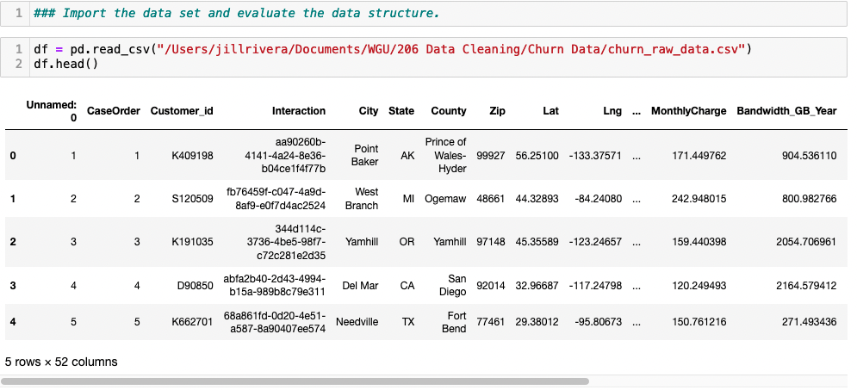
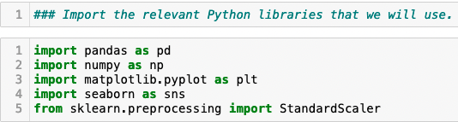
Data Cleaning: Libraries and Loading
Notes:
First step on our data cleaning journey will include importing the Python libraries that we will need for this analysis. I will be using Pandas and Numpy to transform the data into a manageable form. I will use Matplotlib and Seaborn to visualize the data in graphs and charts. Lastly, I will use Scikit Learn to perform the principal component analysis. After these are imported, we can load the data file titled “churn_raw_data” with the read_csv command in Pandas. Using the head command, we can now see the raw data’s first 5 rows. We can also verify that we have all 52 columns.

Slide 8
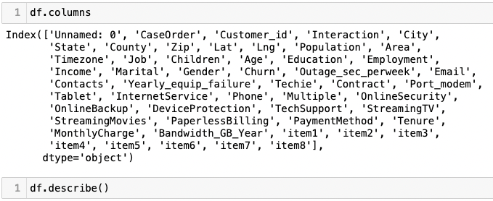
Data Cleaning: View the Columns
Notes:
Now, we need to look at the column names. In doing this, we see that there are eight columns labeled item 1 through item 8. From the data dictionary, we can see that those are our survey response columns.

Slide 9
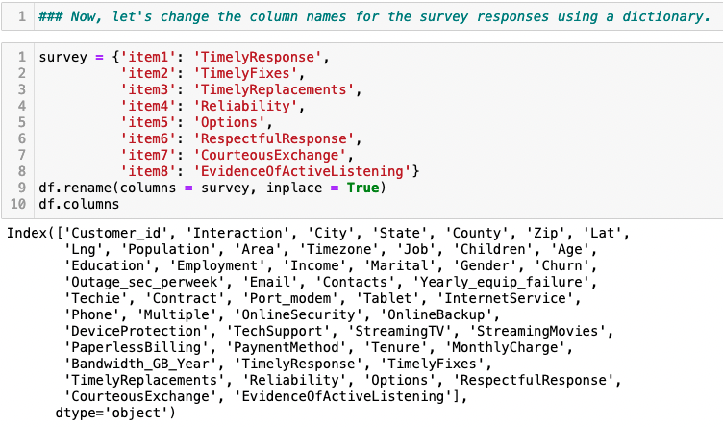
Data Cleaning: Rename Columns
Notes:
Now, we will rename the columns from the customer satisfaction survey to clean up the data. To do this, I created a dictionary of the current column name and what I would like it to be changed to. Then I use this dictionary in a rename command and state that it should be changed in place and not create a new column. Then we check the column names again to make sure they are all changed.

Slide 10
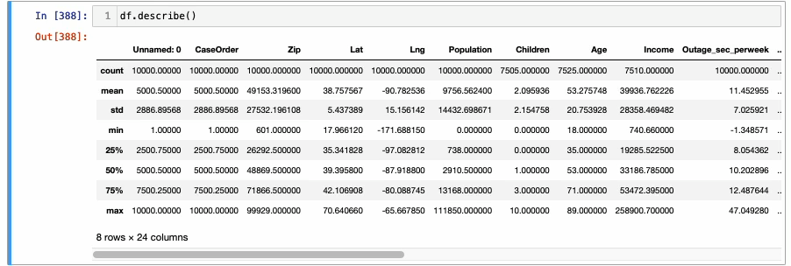
Data Cleaning: Explore Data Structure
Notes:
Next, we can look at the structure of our numerical data and look at their statistics. We can see that we have our 10,000 rows of customer data. Using the describe command we can see the number of missing variables in each column in the count row. It also calculates the mean, standard deviation, min and max for each column. Describe also breaks the data into quartiles for analysis. From this, we can see what variables may not be beneficial to our analysis. We can also get some facts about our data. Looking at the second row, which is the mean row, we can see that the average customer is 52 years old and pays $174.08 monthly to the company. In looking at the survey results, we can see that all 8 responses have averaged a value of 3.5 out of 5. This tells us that the customers as a collective are marginally satisfied with their service.

Slide 11
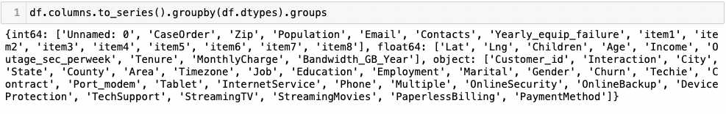
Data Cleaning: Data Types
Notes:
Using the groupby command, we can view the data types and see how many are in each group. We currently have 15 variables that are integers, 9 that are floats and 28 variables that are objects. The bulk of the object types are categorical data. In a later step, we will separate the numerical and categorical data for analysis.

Slide 12
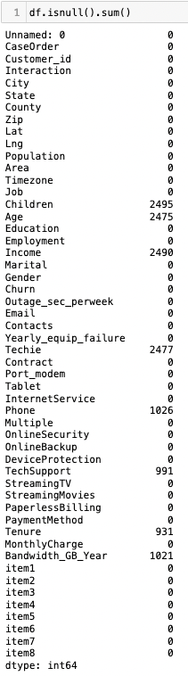
Data Cleaning: Find Missing Values
Notes:
We know the types, now let’s see how many missing values are in each column. Using the isnull command, along with the sum command, we can see the total number of missing values in each column. We can see that children, age, income, techie, phone, tech support, tenure, and bandwidth_GB_year are the columns with missing values. We do not know the reason for this missing data, and that is a limitation of the data set. We do have a few tricks that can be used to deal with these missing values, however.

Slide 13
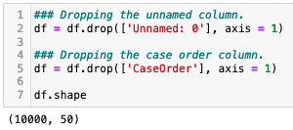
Data Cleaning: Drop Irrelevant Variables
Notes:
Now, we can drop some variables that are not relevant to our churn question. Using the drop command, I eliminate the unnamed and case order columns. I use the shape command to verify that the columns are gone. We now have 50 columns and 10,000 rows.

Slide 14
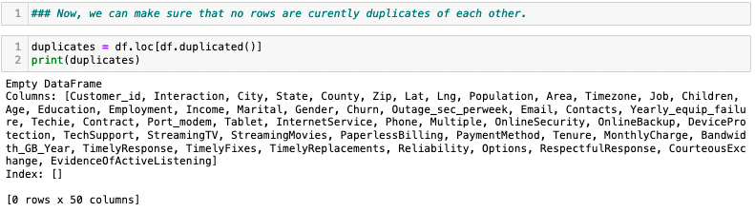
Data Cleaning: Duplicate Rows
Notes:
Now, let’s make sure that we do not have any rows of data that are duplicated. I use the duplicated command to verify that there are no rows that are duplicates of each other.

Slide 15
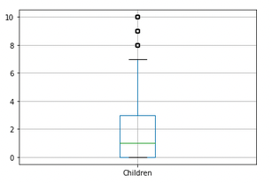
Data Cleaning: Outlying Values
Notes:
We can now begin to detect and address if there are any outlying values in numerical columns. First, we look at the children column in a boxplot. This makes it very easy to see that we have three outlying values at 8, 9 and 10. We can also see from this graph that the average is 1 child per household and the range of values is between 0 and 3 children per household. We have the choice to either drop this data or drop only the outliers. Since the number of children in a household is unlikely going to lead to a customer churning, we will drop the variable.

Slide 16
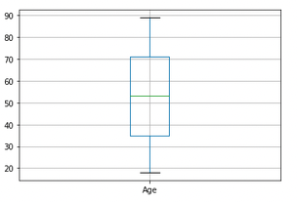
Data Cleaning: Outlying Values
Notes:
Moving on to the age variable, we view it in a boxplot. We can see that the range of customer ages is between 35 and 71, and the average age is 53. We do not see any outlying values, so this data is valuable to keep for analysis.

Slide 17
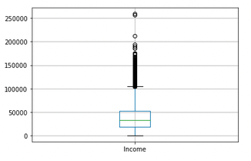
Data Cleaning: Outlying Values
Notes:
We see a completely different story when looking at income in a boxplot. The range of values is between $15,000 and $55,000 yearly and the average is around $40,000. We have several outlying figures however that will throw off future calculations. We will remove this variable as it has too many values to address, and the likelihood of this effecting churn is low.

Slide 18
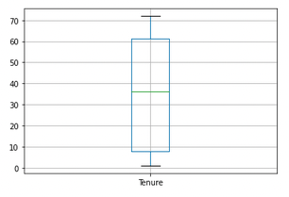
Data Cleaning: Outlying Values
Notes:
Looking at tenure in a boxplot, we can see a very big range of values. This variable is the number of months that a customer has been with the service. The range goes from 8 months to 62 months and averages at 36 months. There are no outliers with this variable. Even though there is big range of values, we will keep this information in the analysis.

Slide 19
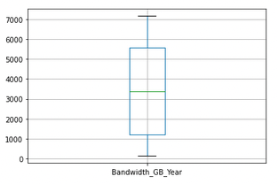
Data Cleaning: Outlying Values
Notes:
The last variable we will look at in a boxplot is the bandwidth_GB_year column. We see no outlying factors in this variable. The customers average 3400 GB of data usage per year and ranges from 1100 to 5600 GB yearly. This data will be kept for analysis as well.

Slide 20
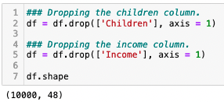
Data Cleaning: Drop Irrelevant Variables
Notes:
We determined two variables that we no longer need, so we can remove them using the drop command again. We now have 48 variables and 10,000 rows of data.

Slide 21
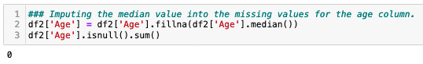
Data Cleaning: Fill Missing Values
Notes:
Let’s begin to address the missing values in the data that we found. We already dropped 2 of the variables with missing data. Now we will look at the age variable. We can recall that this column had 2475 missing values. Using central tendencies, we can impute a value for the missing data. Using the fillna command, we can fill the value with the average of that column. Using the average is a safe way to fill missing values for a variable like this so that further calculations are not skewed by the data that we impute. Using the isnull and sum commands, we make sure that the fields were filled.

Slide 22
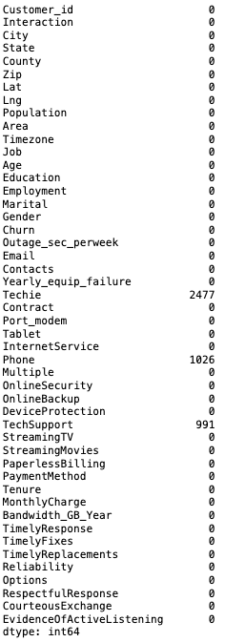
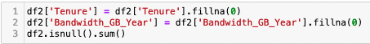
Data Cleaning: Fill Missing Values
Notes:
Next the tenure and bandwidth columns will be addressed. These columns had 931 and 1021 missing values respectively. We can make an assumption with this data that the missing fields are due to the customer being a new customer. We can then safely fill those missing values with a 0 using the fillna command again. Verifying that there are no more missing values in these columns, we can see that we are left with three columns to address; techie, phone and tech support.

Slide 23
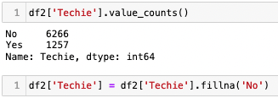
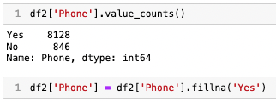
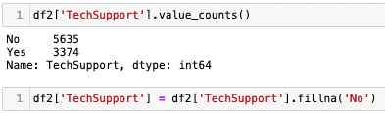
Data Cleaning: Fill Missing Values
Notes:
These three columns have yes/no responses as values. Using the value_counts command, I find out the value that occurs most often for each variable. Then, I fill the missing values with the most frequent value. In this case, the techie missing values were filled with no, the tech support fields were filled with no, and the phone fields were filled with yes. This way the data stays as consistent as possible.

Slide 24
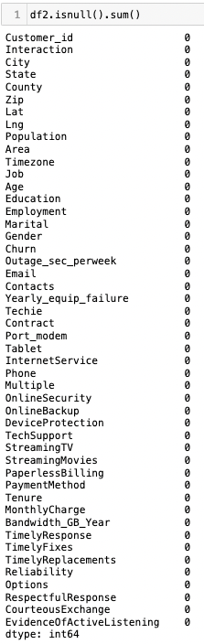
Data Cleaning: Check For Missing Values
Notes:
One last check to make sure that our data set has no missing values.

Slide 25
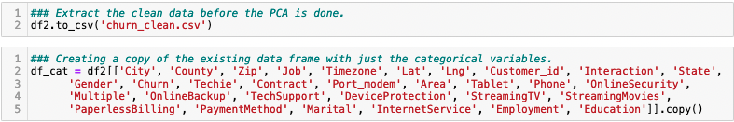
Data Cleaning: Extracting Clean Data Set
Notes:
Finally, we are done cleaning the data set and we can prepare the data set for the PCA. I extracted the clean data and labeled it churn_clean.csv using the to_csv command. Next, I separate the categorical variables into a separate data frame for the PCA. I called this df_cat.

Slide 26
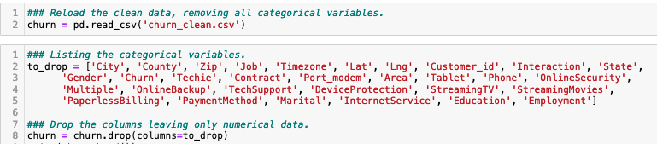
Data Cleaning: Categorical Variables
Notes:
The clean data is now reloaded, and the categorical columns are dropped since we already have them in a separate data frame. The columns are dropped by first creating a list of the columns named to_drop, and then using the drop command like we did before.

Slide 27
Principal Component Analysis (PCA)
Reduces dimensionality of the data.
Focuses the results on the most correlated features.
Numerical data is normalized, the number of components is determined, and variances are calculated.
Scree plot is produced.
Explained variance ratio and cumulative sum of the variances are calculated.
Logistic Regression and Random Forest Classifiers are run on the model with and without PCA.
Notes:
Finally, we are at the step where we can perform the principal component analysis. PCA reduces the dimensionality of a data set to focus on the variables that have the most correlation to each other. I will create a pipeline using the powerful scikit-learn tools. This pipeline will normalize the data, determine the number of components that are needed to describe the data with accuracy, and the variances between all the variables. A scree plot will be produced to see the bend in the diagram and visualize how the variables work together to explain the data. Using explained variance ration and cumulative sum, I will determine the principal components needed for the model. Finally, logistic regression and random forest classifiers will be run with and without PCA to test our model’s prediction accuracy.

Slide 28
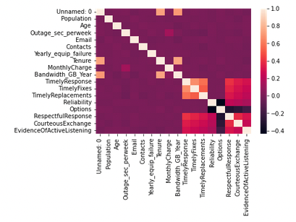
PCA: Correlation Heatmap
Notes:
Beginning with a correlation heatmap, we can see the correlation between all the variables in our churn data set. We can see that tenure, bandwidth, timely response and timely fixes have strong correlations, while reliability and options are weakly corelated.

Slide 29
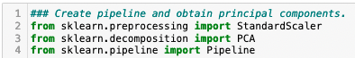
PCA: Import Pipeline Libraries
Notes:
To create a pipeline and preform the analysis, we need to first import the tools from scikit-learn that we will need. We will use standard scaler, PCA and pipeline for this analysis.

Slide 30
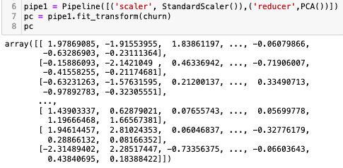
PCA: PCA Pipeline
Notes:
To create the pipeline, we set the scaler to standard scaler, and the reducer to PCA. We then fit and transform the data into the pipeline. The result is shown in the array.

Slide 31
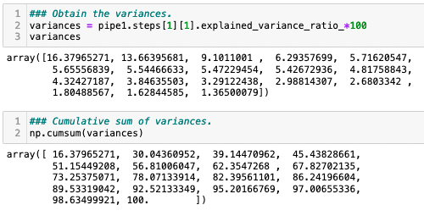
PCA: Variances
Notes:
Now we need to get the variances between the values. The variances are calculated using the explained variance ratio command and multiplying by 100 to make it a percentage. The resulting array is the percentage of variance for each component. We can see that the first three components are varied highly and therefore will throw off the model. Using the cumsum command, we can see the cumulative totals of the variances. From this array, we see that 11 components are needed to maintain 82% accuracy for the model.

Slide 32
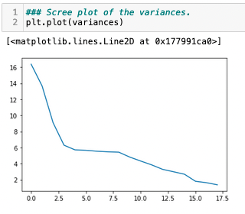
PCA: Scree Plot
Notes:
Let’s verify this information and find the range of components that we need for our model. A scree plot is a useful tool to do this. The bend or elbow in the graph signifies the components prior to it are skewing the model. From this graph, choosing components 3 through 14 would give us the 11 components needed at the lowest variance between them as possible.

Slide 33
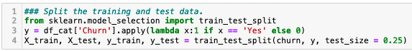
PCA: Training and Testing Data Split
Notes:
Before we preform regression calculations on the data set, it is broken into training and testing sets. Using the train_test_split tool from scikit-learn, we make split the data to 25% test and 75% training.

Slide 34
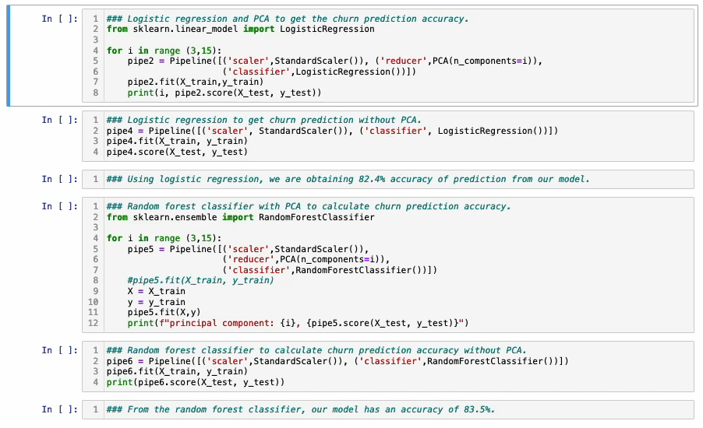
PCA: Logistic Regression With PCA
Notes:
Scikit-learn’s logistic regression classifier tool is easy to use. It is an algorithm that predicts the probability of a categorical dependent variable. First, the tool is imported, then a loop is created to cycle each of the components we identify through the algorithm. We can see that the 11 components that I chose all have a probability above 71%, which is an indicator that our model is good.

Slide 35
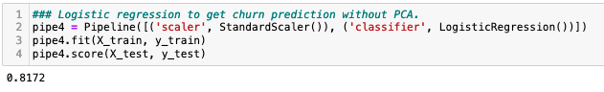
PCA: Logistic Regression Without PCA
Notes:
Using logistic regression without PCA tests our model overall. This calculation shows that the model has an accuracy prediction of 81.7%, which is great. We can say with confidence that our model has a high accuracy rate.

Slide 36
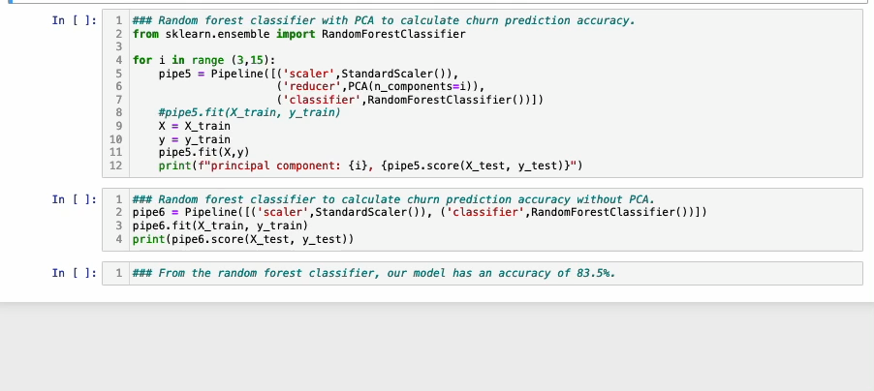
PCA: Random Forest Classifiers With PCA
Notes:
Random forest classifiers from scikit-learn is another way that the model can be tested for prediction accuracy. It uses an ensemble method to create a bunch of decision trees on the components and selects the components with the most trees. When running this algorithm on the selected components, we can see a prediction accuracy above 72% for each component. This again proves that the components are correct, and the model is accurate.

Slide 37
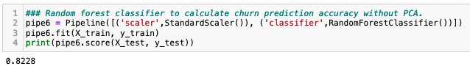
PCA: Random Forest Classifiers Without PCA
Notes:
Running the random forest classifier on the entire model without PCA shows a prediction accuracy of 82.3%.

Slide 38
Results
Principal Components (11):
Age
Outage_sec_perweek
Email
Contacts
Yearly_equip_failure
Tenure
Monthly Charge
Bandwidth_GB_Year
Timely Response
Timely Fixes
Timely Replacements
Reliability.
Model Prediction Accuracy: 83%
Notes:
In summary, we were given a telecommunications customer data set and asked to figure out what variables are leading to the current customer churn rate. We examined the data set to discover several missing values, no duplicated rows, and columns that were not labeled correctly. We cleaned the data set by imputing central tendencies and logical figures for missing values, dropping unnecessary columns, and visualizing along the way to make sure that we are on the right track. Once the data was clean and manageable, The data set was split into numerical and categorical data frames. A principal component analysis was performed to reduce the dimensionality. This gave us the main eleven components that are crucial to explaining the data model with accuracy. This components are Age, Outage_sec_perweek, Email, Contacts, Yearly_equip_failure, Tenure, Monthly Charge, Bandwidth_GB_Year, Timely Response, Timely Fixes, Timely Replacements, and Reliability. The model created was tested for prediction accuracy using logistic regression and random forest classifiers. The model proved to have an 83% prediction accuracy overall. This means that we created useful tool for the company to predict churn rates for customers. If they improve in the categories of the eleven principal components, they will reduce the rate of customer churn for the company.

Slide 39

Questions
Notes:
We have provided actionable insight into how to retain customers for this telecommunications company. Any questions?

